Slide 1
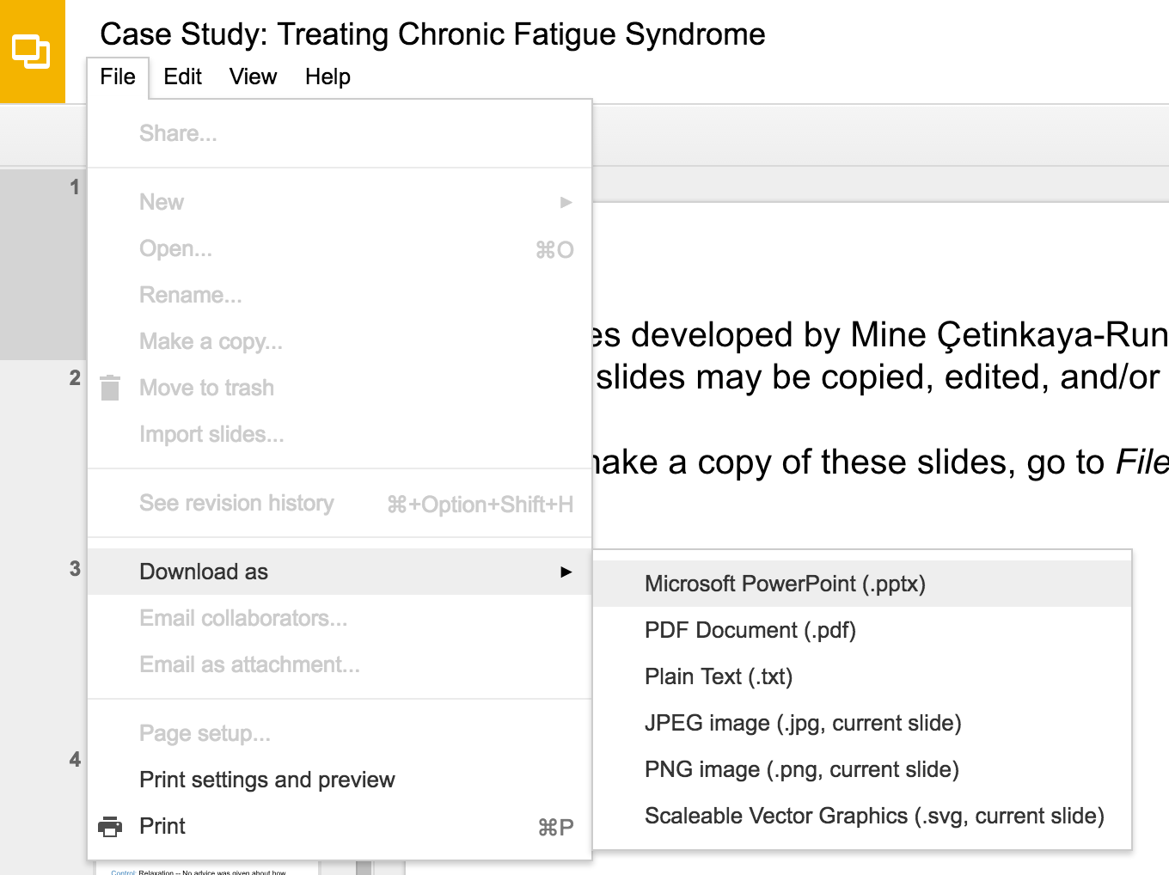
Slides developed by Mine Çetinkaya-Rundel of OpenIntro
Translated from LaTeX to Google Slides by Curry W. Hilton of OpenIntro.
The slides may be copied, edited, and/or shared via the CC BY-SA license
To make a copy of these slides, go to File > Download as > [option], as shown below. Or if you are logged into a Google account, you can choose Make a copy... to create your own version in Google Drive.

Slide 2
Geometric Distribution

Slide 3
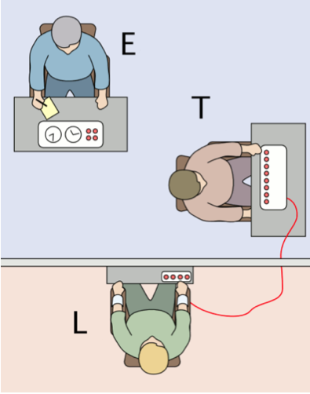
Milgram experiment
Stanley Milgram, a Yale University psychologist, conducted a series of experiments on obedience to authority starting in 1963.
Experimenter (E) orders the teacher (T), the subject of the experiment, to give severe electric shocks to a learner (L) each time the learner answers a question incorrectly.
The learner is actually an actor, and the electric shocks are not real, but a pre-recorded sound is played each time the teacher administers an electric shock.
http://en.wikipedia.org/wiki/File:Milgram_Experiment_v2.png

Slide 4
Milgram experiment (cont.)
These experiments measured the willingness of study participants to obey an authority figure who instructed them to perform acts that conflicted with their personal conscience.
Milgram found that about 65% of people would obey authority and give such shocks.
Over the years, additional research suggested this number is approximately consistent across communities and time.

Slide 5
Bernoulli random variables
Each person in Milgram's experiment can be thought of as a trial.
A person is labeled a success if she refuses to administer a severe shock, and failure if she administers such shock.
Since only 35% of people refused to administer a shock, probability of success is p = 0.35.
When an individual trial has only two possible outcomes, it is called a Bernoulli random variable.

Slide 6

Geometric distribution
Dr. Smith wants to repeat Milgram's experiments but she only wants to sample people until she finds someone who will not inflict a severe shock. What is the probability that she stops after the first person?

Slide 7
Geometric distribution
Dr. Smith wants to repeat Milgram's experiments but she only wants to sample people until she finds someone who will not inflict a severe shock. What is the probability that she stops after the first person?
... the third person?

Slide 8
Geometric distribution
Dr. Smith wants to repeat Milgram's experiments but she only wants to sample people until she finds someone who will not inflict a severe shock. What is the probability that she stops after the first person?
... the third person?
... the tenth person?

Slide 9
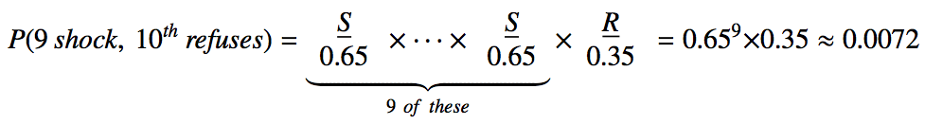
Geometric distribution
Dr. Smith wants to repeat Milgram's experiments but she only wants to sample people until she finds someone who will not inflict a severe shock. What is the probability that she stops after the first person?
... the third person?
... the tenth person?

Slide 10
Geometric distribution (cont.)
The geometric distribution describes the waiting time until a success for independent and identically distributed (iid) Bernoulli random variables.
independence: outcomes of trials don't affect each other
identical: the probability of success is the same for each trial

Slide 11
Geometric distribution (cont.)
The geometric distribution describes the waiting time until a success for independent and identically distributed (iid) Bernoulli random variables.
independence: outcomes of trials don't affect each other
identical: the probability of success is the same for each trial
Geometric probabilities
If p represents probability of success, (1 - p) represents probability of failure, and n represents number of independent trials

Slide 12
Practice
Can we calculate the probability of rolling a 6 for the first time on the 6th roll of a die using the geometric distribution? Note that what was a success (rolling a 6) and what was a failure (not rolling a 6) are clearly defined and one or the other must happen for each trial.
no, on the roll of a die there are more than 2 possible outcomes
yes, why not

Slide 13
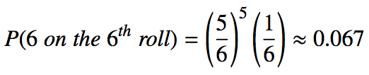
Practice
Can we calculate the probability of rolling a 6 for the first time on the 6th roll of a die using the geometric distribution? Note that what was a success (rolling a 6) and what was a failure (not rolling a 6) are clearly defined and one or the other must happen for each trial.
no, on the roll of a die there are more than 2 possible outcomes
yes, why not

Slide 14
Expected value
How many people is Dr. Smith expected to test before finding the first one that refuses to administer the shock?

Slide 15

Expected value
How many people is Dr. Smith expected to test before finding the first one that refuses to administer the shock?
The expected value, or the mean, of a geometric distribution is defined as 1/p

Slide 16
Expected value
How many people is Dr. Smith expected to test before finding the first one that refuses to administer the shock?
The expected value, or the mean, of a geometric distribution is defined as 1/p
She is expected to test 2.86 people before finding the first one that refuses to administer the shock.

Slide 17
Expected value
How many people is Dr. Smith expected to test before finding the first one that refuses to administer the shock?
The expected value, or the mean, of a geometric distribution is defined as 1/p
She is expected to test 2.86 people before finding the first one that refuses to administer the shock.
But how can she test a non-whole number of people?

Slide 18
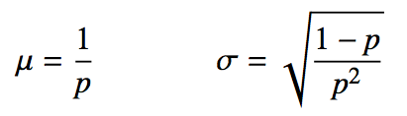
Expected value and its variability
Mean and standard deviation of geometric distribution

Slide 19
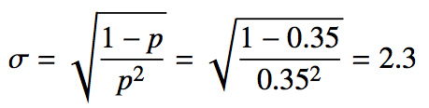
Expected value and its variability
Mean and standard deviation of geometric distribution
Going back to Dr. Smith's experiment:

Slide 20
Expected value and its variability
Mean and standard deviation of geometric distribution
Going back to Dr. Smith's experiment:
Dr. Smith is expected to test 2.86 people before finding the first one that refuses to administer the shock, give or take 2.3 people.

Slide 21
Expected value and its variability
Mean and standard deviation of geometric distribution
Going back to Dr. Smith's experiment:
Dr. Smith is expected to test 2.86 people before finding the first one that refuses to administer the shock, give or take 2.3 people.
These values only make sense in the context of repeating the experiment many many times.

Slide 22
Find more resources at openintro.org/os, including
Slides
Videos
Statistical Software Labs
Discussion Forums (free support for students and teachers)
Learning Objectives
Teachers only content is also available for Verified Teachers, including
Exercise solutions
Sample exams
Ability to request a free desk copy for a course
Statistics Teachers email group
Questions? Contact us.

